Slide 1

SRM INSTITUTE OF SCIENCE AND TECHNOLOGY, Ramapuram SCHOOL OF COMPUTER SCIENCE AND ENGINEERING DEPARTMENT OF COMPUTER SCIENCE AND ENGINEERING 21CSP302L - PROJECT
III year /VI Sem First Review
Class/Sec : CSE – IoT / A
SMART AUTOMATED PLANT WATERING SYSTEM WITH SENSORS
Batch No.: 02
Team Members | Supervisor
Chandra Sekhar Dutta (RA2211032020010) Anuj Singh (RA2211032020013) Ram sanjay (RA2211032020030) | NAME: Dr. E. Saraswathi

Slide 2
AGENDA
Abstract
Introduction
Objectives
Scope
Architectural Diagram
Flow Diagram
List of Modules
Literature Review
References

Slide 3
ABSTRACT
The Smart Automated Plant Watering System uses sensors and automation to manage irrigation based on real-time environmental conditions. It integrates soil moisture, temperature, and humidity sensors to monitor plant needs. When soil moisture levels drop below a threshold, a microcontroller activates a water pump. IoT connectivity allows remote monitoring and control via a mobile app or web interface. This technology minimizes water wastage, reduces manual intervention, and ensures optimal plant health, making it ideal for home gardens, greenhouses, and agricultural applications.

Slide 4
INTRODUCTION
A Smart Automated Plant Watering System has been developed to address water wastage and overwatering in plant growth. The system uses soil moisture, temperature, and humidity sensors to monitor environmental conditions. A microcontroller processes sensor data and activates a water pump when soil moisture levels fall below a predefined threshold. It integrates IoT technology, allowing remote monitoring and control via a smartphone or web application. This system promotes sustainable farming, water conservation, and improved plant health, making it ideal for home gardens, greenhouses, and agricultural fields.

Slide 5
OBJECTIVES
Efficient Water Management
To optimize water usage by providing the right amount of water based on real-time soil moisture levels.
Automation of Irrigation
To reduce manual intervention by automating the watering process using sensors and microcontrollers.
Prevention of Overwatering and Underwatering
To maintain optimal soil moisture levels, ensuring healthier plant growth and preventing water-related plant diseases.
Integration of IoT for Remote Monitoring
To enable users to monitor and control the system remotely through a mobile app or web interface.
Scalability for Different Applications
To develop a system that can be implemented in home gardens, greenhouses, and large agricultural fields.

Slide 6
SCOPE
The Smart Automated Plant Watering System with Sensors is a versatile solution for various environments, including home gardening, greenhouses, agricultural fields, urban landscaping, IoT integration, energy efficiency, customization, and environmental sustainability. It can be used for small-scale plant care, greenhouses, agricultural fields, and urban landscaping. The system ensures optimal watering conditions, improves crop yield, and conserves water. It can be designed for solar power or battery-operated microcontrollers, making it suitable for rural areas with limited electricity. The system is modular, adaptable for different plant types, soil conditions, and irrigation needs, making it suitable for both small and large-scale applications. It promotes water conservation and efficient resource utilization, making it a valuable solution for the future of smart agriculture.

Slide 7
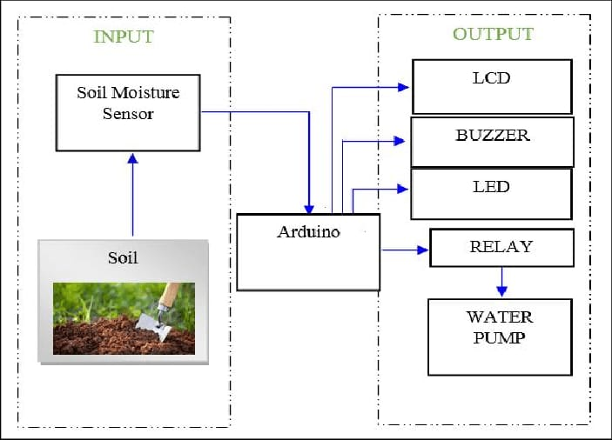
ARCHITECTURAL DIAGRAM

Slide 8
LIST OF MODULES
Sensor Module
Includes soil moisture sensors, temperature sensors, and humidity sensors to collect real-time environmental data.
Provides precise readings for optimizing irrigation cycles.
Microcontroller Module
Processes sensor data and makes decisions based on predefined threshold values.
Commonly implemented using Arduino, ESP8266, ESP32, or Raspberry Pi, depending on system complexity.
Water Pump Control Module
Activates the water pump when soil moisture drops below the required level.
Utilizes relay switches or MOSFETs for efficient pump control.
Power Supply Module
Provides the necessary power to sensors, microcontrollers, and pumps.

Slide 9
LIST OF MODULES
IoT & Communication Module
Integrates with Wi-Fi, GSM, LoRa, or Bluetooth for remote monitoring and control.
Enables data storage on cloud platforms.
User Interface Module
Provides a mobile app or web dashboard for real-time monitoring and manual control.
Can integrate with voice for smart home automation.
Data Logging & Analytics Module
Stores historical data for trend analysis, predictive irrigation, and water usage optimization.
Uses databases like MySQL, Firebase, or cloud-based solutions.

Slide 10
LITERATURE SURVEY 1
S.No | Title of the paper | Year | Journal/Conferance Name | Inferences
1 | IoT Based Automatic Plant Watering System Through Soil Moisture Sensing— A Technique to Support Farmers’ Cultivation in Rural India | 2020 | ResearchGate | Uses soil moisture sensors to automate irrigation, reducing the need for human intervention in farming.

Slide 11
LITERATURE SURVEY 2
S.No | Title of the paper | Year | Journal/Conferance Name | Inferences
2 | IoT-Based Smart Watering System Towards Improving the Efficiency of Agricultural Irrigation | 2020 | IEEE Xplore | Optimizes irrigation by using pH and moisture sensors to ensure water is applied only when necessary.

Slide 12
LITERATURE SURVEY 3
S.No | Title of the paper | Year | Journal/Conferance Name | Inferences
3 | Automatic Watering System for Plants with IoT Monitoring and Notification | 2018 | Cogito Smart Journal | VOL. 4 | Integrates IoT to allow remote monitoring and notifications, improving user control over plant watering.

Slide 13
LITERATURE SURVEY 4
S.No | Title of the paper | Year | Journal/Conferance Name | Inferences
4 | IoT Based Smart Plant Irrigation System with Enhanced learning | 2021 | IEEE Xplore | Uses adaptive learning to optimize irrigation schedules based on environmental data and user inputs.

Slide 14
LITERATURE SURVEY 5
S.No | Title of the paper | Year | Journal/Conferance Name | Inferences
5 | IOT-BASED PLANT WATERING SYSTEM | 2024 | International Research Journal of Modernization in Engineering Technology and Science | Employs sensors to monitor temperature, humidity, and moisture levels, automating and optimizing irrigation.

Slide 15
REFERENCES
Ahmed, S. M., Kovela, B., & Gunjan, V. K. (2020). IoT-Based Automatic Plant Watering System Through Soil Moisture Sensing—A Technique to Support Farmers’ Cultivation in Rural India. In V. Gunjan, S. Senatore, A. Kumar, X.-Z. Gao, & S. Merugu (Eds.), Advances in Cybernetics, Cognition, and Machine Learning for Communication Technologies (Lecture Notes in Electrical Engineering, Vol. 643, pp. 307–317). Springer, Singapore. https://doi.org/10.1007/978-981-15-3125-5_28
Hossain, M. A., Rahman, M. S., & Islam, M. S. (2021). IoT-Based Smart Watering System Towards Improving the Efficiency of Agricultural Irrigation. 2021 International Conference on Automation, Control and Mechatronics for Industry 4.0 (ACMI), IEEE, pp. 1–5. https://doi.org/10.1109/ACMI53878.2021.9528172
Nugroho, A. S., Wibowo, A. S., & Rahmat, R. F. (2019). Automatic Watering System for Plants with IoT Monitoring and Notification. Journal of Physics: Conference Series, 1196, 012014. https://doi.org/10.1088/1742-6596/1196/1/012014

Slide 16
Nandurkar, S. R., Thool, V. R., & Thool, R. C. (2021). IoT-Based Smart Plant Irrigation System with Enhanced Learning. 2021 International Conference on Artificial Intelligence and Smart Systems (ICAIS), IEEE, pp. 1–5. https://doi.org/10.1109/ICAIS50930.2021.9398892
Patil, S. S., Patil, P. R., & Patil, R. S. (2024). IoT-Based Plant Watering System. International Research Journal of Modernization in Engineering Technology and Science, 6(11), 144–148. https://www.irjmets.com/uploadedfiles/paper/issue_11_november_2024/64463/final/fin_irjmets1732559499.pdf
Punitharaja, K., & Suresh, S. (2019). Application of IoT in Plant Watering System. Journal of Emerging Technologies and Innovative Research, 6(5), 45-50.
Binayao, R. P., Mantua, P. V. L., Namocatcat, H. R. M. P., Seroy, J. K. K. B., Sudaria, P. R. A. B., Gumonan, K. M. V. C., & Orozco, S. M. M. (2024). Smart Water Irrigation for Rice Farming through the Internet of Things. arXiv preprint arXiv:2402.07917.

Slide 17
Risheh, A., Jalili, A., & Nazerfard, E. (2020). Smart Irrigation IoT Solution Using Transfer Learning for Neural Networks. arXiv preprint arXiv:2009.12747.
Karar, M. E., Alotaibi, F., AL Rasheed, A., & Reyad, O. (2021). A Pilot Study of Smart Agricultural Irrigation Using Unmanned Aerial Vehicles and IoT-Based Cloud System. arXiv preprint arXiv:2101.01851.
Aydin, Ö., Kandemir, C. A., Kiraç, U., & Dalkiliç, F. (2021). An Artificial Intelligence and Internet of Things Based Automated Irrigation System. arXiv preprint arXiv:2104.04076.

